Slide 1
ANALYSIS OF CUSTOMER RETENTION DATASET
-BY SUSHREE SMITA NAYAK

Slide 2
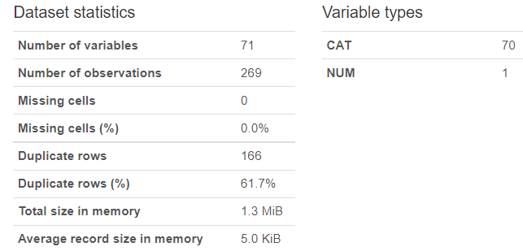
ABOUT THE DATASET
THE data set contains 71 features or factors. And data of 269 customers are recorded.
The data is collected from the Indian online shoppers. Results indicate the e-retail success factors, which are very much critical for customer satisfaction
All the data are object datatypes except pincode which is of integer data type
There are no null values or missing values

Slide 3
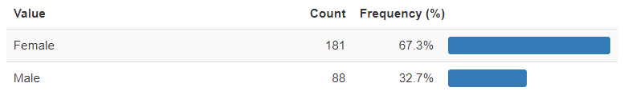
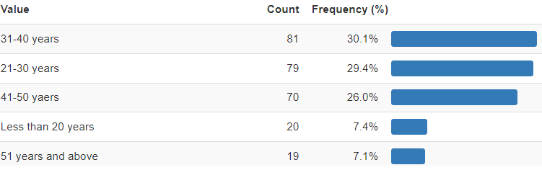
UNIVARIATE ANALYSIS: DEMOGRAPHCS
GENDER OF CORRESPORNDENT:
OBSERVATION1: Females shop more online when compared to males.
HOW OLD ARE YOU?:
OBSERVATION2: Maximum online shoppers belong to the 31-40 age group.

Slide 4
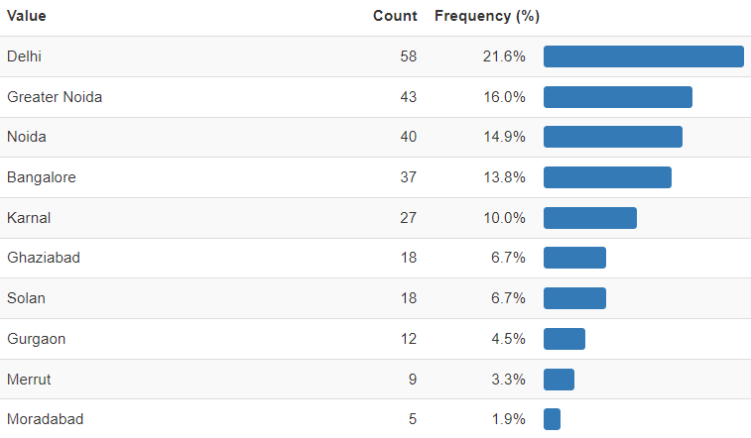
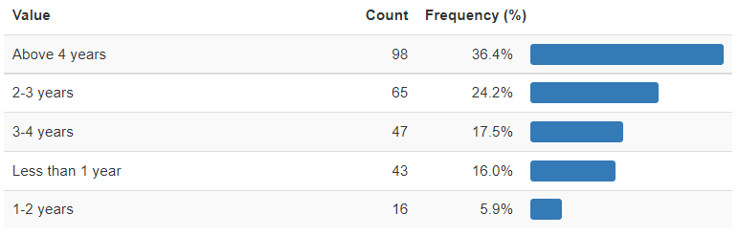
UNIVARIATE ANALYSIS: DEMOGRAPHCS
4.SINCE HOW LONG YOU ARE SHOPPING ONLINE?
3.WHICH CITY DO YOU SHOP ONLINE FROM?
OBSERVATION3:Maximum shoppers belong to Delhi region
OBSERVATION4:Maximum shoppers have shopped online for more than 4 years

Slide 5
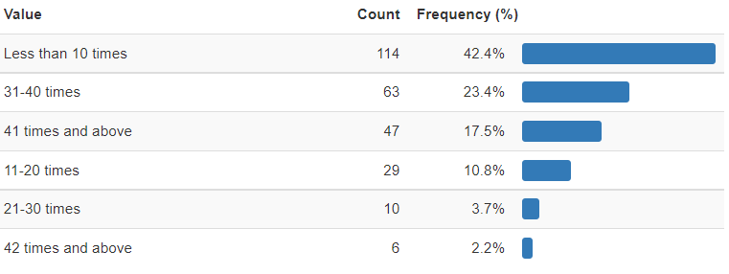
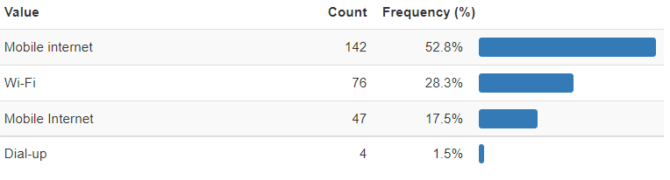
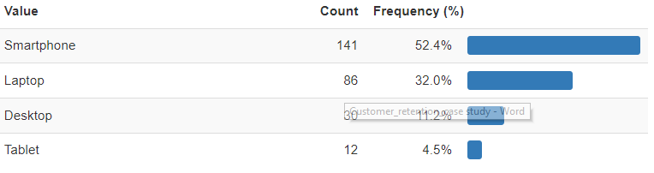
UNIVARIATE ANALYSIS: PURCHASE ANALYSIS
6.HOW DO YOU ACCESS THE INTERNET WHILE SHOPPING ONLINE?
7.WHICH DEVICE DO YOU USE TO ACCESS THE ONLINE SHOPPING?
5.HOW MANY TIMES HAVE YOU MADE AN ONLINE PURCHASE IN THE PAST YEAR?
OBSERVATION5: Most of the online shoppers have bought less than 10 times in the past year. Also only 2.2% (lowest)bought maximum(42 and above) online.
OBSERVATION6: maximum (52.8%) shoppers use mobile internet.
OBSERVATION7: most of the shoppers uses smart phone to purchase online.

Slide 6
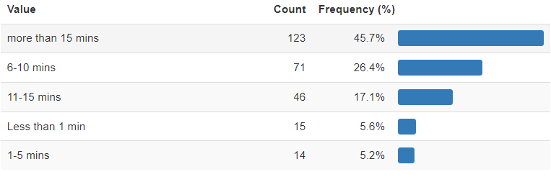
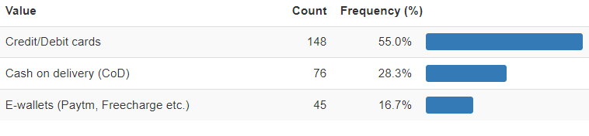
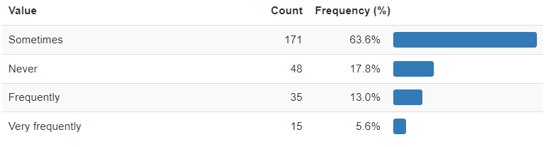
UNIVARIATE ANALYSIS: PURCHASE ANALYSIS
9. WHAT IS YOUR PREFERRED PAYMENT OPTION?
10. HOW FREQUENTLY DO YOU ABANDON (SELECTING AN ITEMS AND LEAVING WITHOUT MAKING PAYMENT) YOUR SHOPPING CART?
8.HOW MUCH TIME DO YOU EXPLORE THE E-RETAIL STORE BEFORE MAKING A PURCHASE DECISION?
OBSERVATION: most of the shoppers spend more than 15 mins in the e-retail store before purchasing.
OBSERVATION: most of the customers prefer payment through debit credit cards
OBSERVATION: least no of shoppers very frequently abandon the shopping card without buying

Slide 7
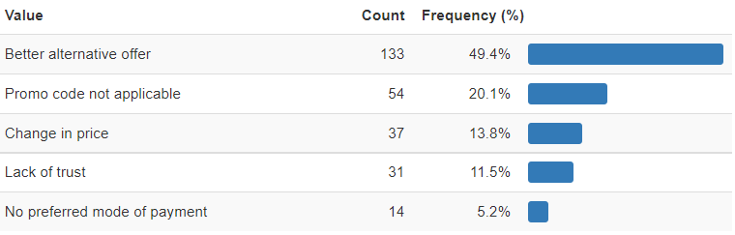
UNIVARIATE ANALYSIS: PURCHASE ANALYSIS
11.WHY DID YOU ABANDON THE SHOPPING CART OR BAG?
OBSERVATION: in most of the cases, shoppers get a better alternative offer which enables them to abandon the shopping cart

Slide 8
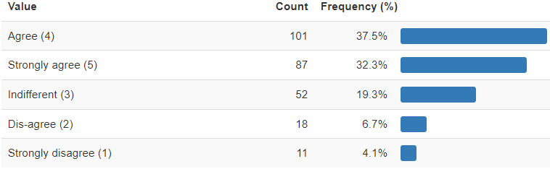
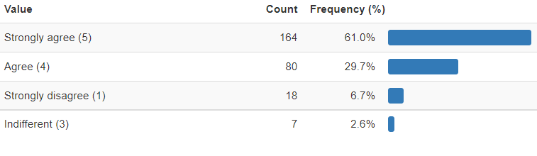
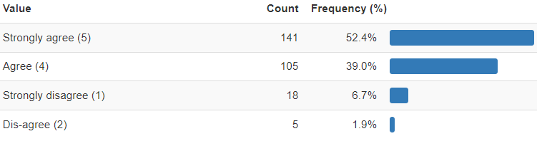
UNIVARIATE ANALYSIS: SHOPPERS EXPECTATION FROM E-RETAILERS
14.EASE OF NAVIGATION OF WEBSITE
13. THE CONTENT ON THE WEBSITE MUST BE EASY TO READ & UNDERSTAND
12.COMPLETE INFORMATION ON LISTED SELLER AND PRODUCT BEING OFFERED IS IMPORTANT FOR PURCHASE DECISION
OBSERVATION: most of the shoppers agree that complete information should be there
OBSERVATION: most of the shoppers strongly agree that the content must be easy to read and understand
OBSERVATION: most of the shoppers strongly agree that ease of navigation in a website is important to efficiently use the website

Slide 9
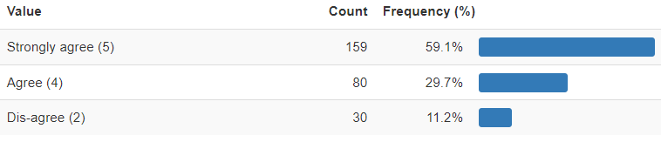
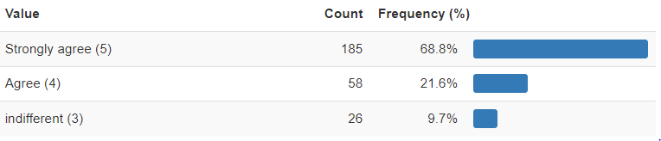
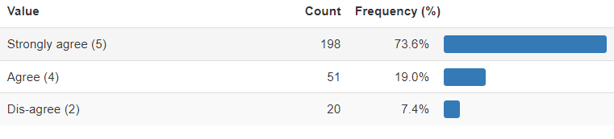
UNIVARIATE ANALYSIS: SHOPPERS EXPECTATION FROM E-RETAILERS
16.BEING ABLE TO GUARANTEE THE PRIVACY OF THE CUSTOMER
17.RETURN AND REPLACEMENT POLICY OF THE E-RETAILER IS IMPORTANT FOR PURCHASE DECISION
15.CONVENIENT PAYMENT METHODS

Slide 10
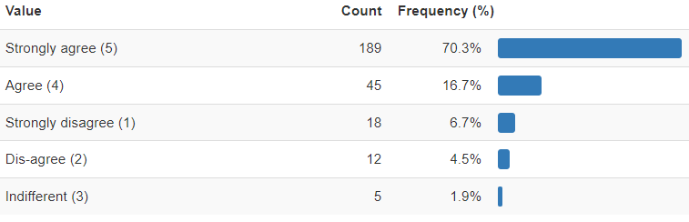
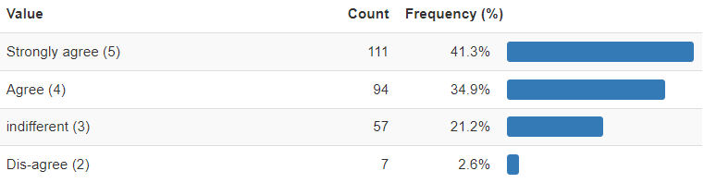
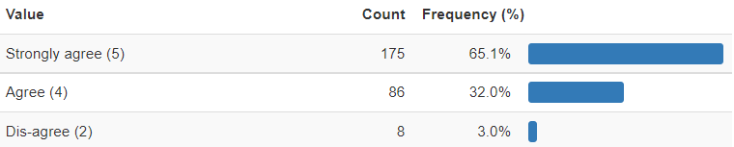
UNIVARIATE ANALYSIS: SHOPPERS EXPECTATION FROM WEBSITE INTERFACE
18.USER FRIENDLY INTERFACE OF THE WEBSITE
19.OFFERING A WIDE VARIETY OF LISTED PRODUCT IN SEVERAL CATAGORY
20.USER DERIVE SATISFACTION WHILE SHOPPING ON A GOOD QUALITY WEBSITE OR APPLICATION
OBSERVATION: most of the shoppers strongly agree that a user friendly interface is necessary
OBSERVATION: 41% majority strongly agree that wide variety of products availability will improve the chance of a customer visit to the website
OBSERVATION: most shoppers strongly agree that user satisfaction gets affected while shopping on a good quality website or application

Slide 11
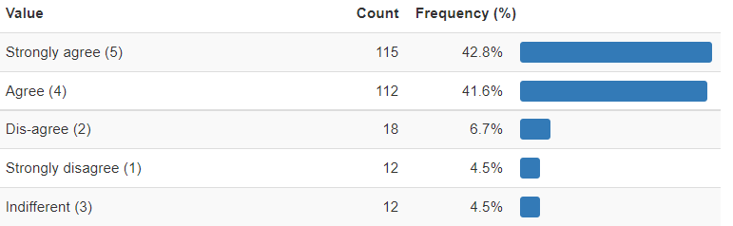
UNIVARIATE ANALYSIS: SHOPPERS EXPECTATION FROM WEBSITE INTERFACE
21.LOADING & PROCESSING SPEED
22.OFFERING A WIDE VARIETY OF LISTED PRODUCT IN SEVERAL CATAGORY
23.USER SATISFACTION WHILE SHOPPING ON A GOOD QUALITY WEBSITE OR APPLICATION

Slide 12
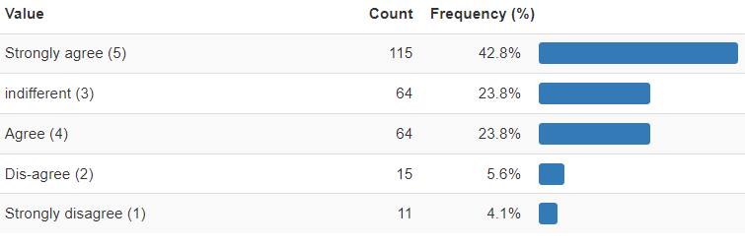
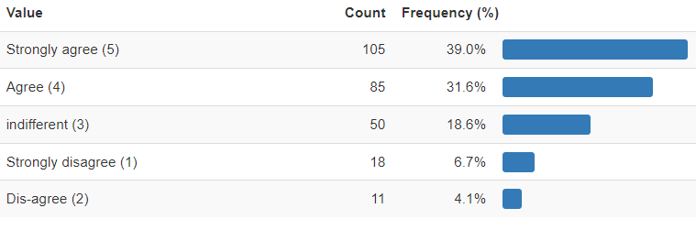
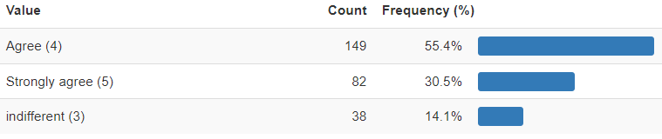
UNIVARIATE ANALYSIS: IS ONLINE SHOPPING BENEFICIAL TO CUSTOMERS?
25. GAINING ACCESS TO LOYALTY PROGRAMS IS A BENEFIT OF SHOPPING ONLINE
26.ONLINE SHOPPING GIVES MONETARY BENEFITS AND DISCOUNTS
24.GETTING VALUE FOR MONEY SPENT

Slide 13
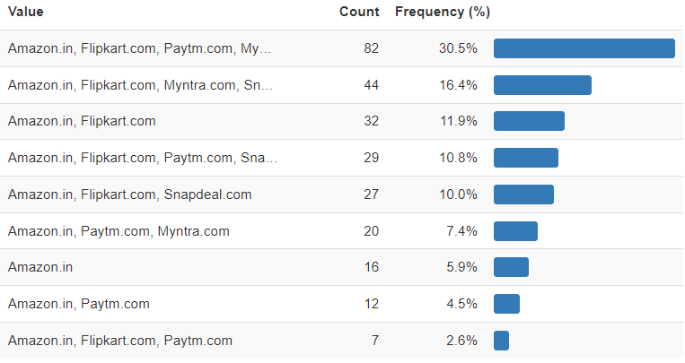
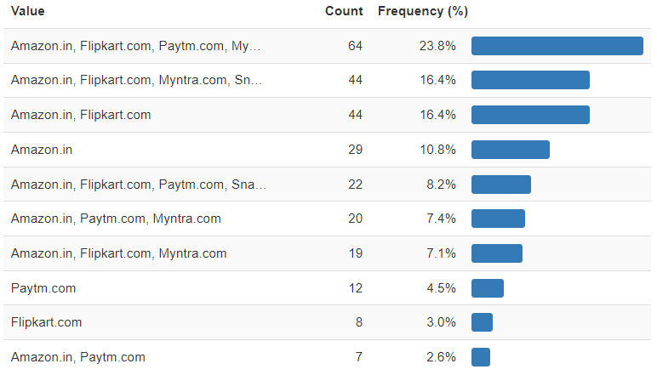
UNIVARIATE ANALYSIS: E-COMMERCE WEBSITE COMPARISON
28.EASY TO USE WEBSITE OR APPLICATION
27.FROM THE FOLLOWING TICK ANT (OR ALL) OF THE ONLINE RETAILERS YOU HAVE SHOPPED FROM?
OBSERVATION: most shoppers have shopped from amazon, flipkart , paytm. myntra
OBSERVATION:most shoppers have concluded that it is easiest to use amazon, flipkart , paytm. myntra

Slide 14
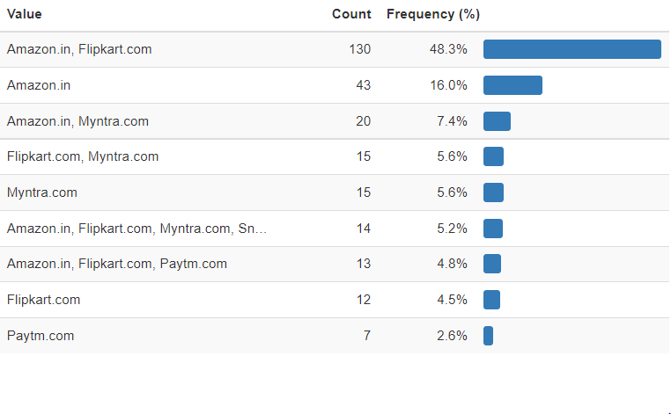
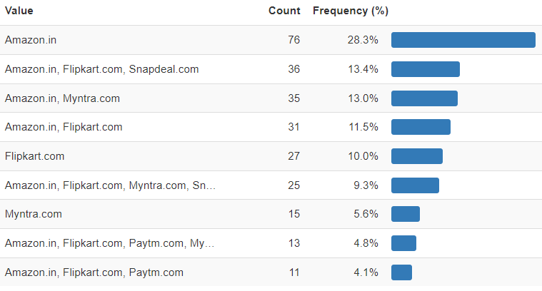
UNIVARIATE ANALYSIS: E-COMMERCE WEBSITE COMPARISON
30.PERCIEVED TRUSTWORTHINESS
29. WIDE VARIETY OF PRODUCT ON OFFER
OBSERVATION: amazon & flipkart has the widest range of products
OBSERVATION: amazon is most trust worthy

Slide 15
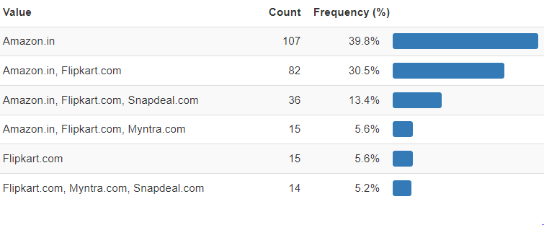
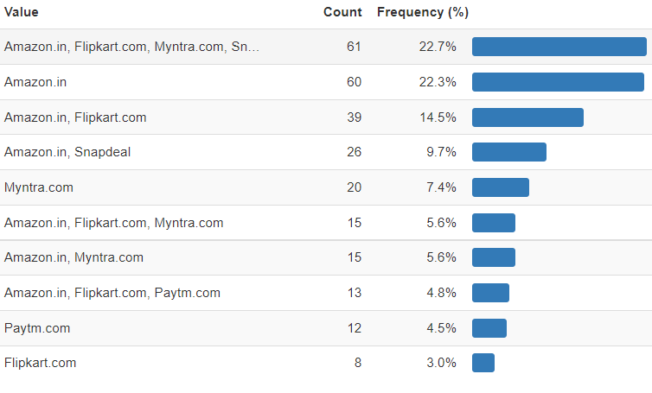
UNIVARIATE ANALYSIS: E-COMMERCE WEBSITE COMPARISON
31.SPEEDY DELIVERY ORDER
32.PRESENCE OF ONLINE ASSISTANCE THROUGH MULTI-CHANNELS
OBSERVATION: amazon has the fastest delivery followed by flipkart
OBSERVATION: amazon, flipkart, myntra and snapdeal have multiple assistance channels to help customers

Slide 16
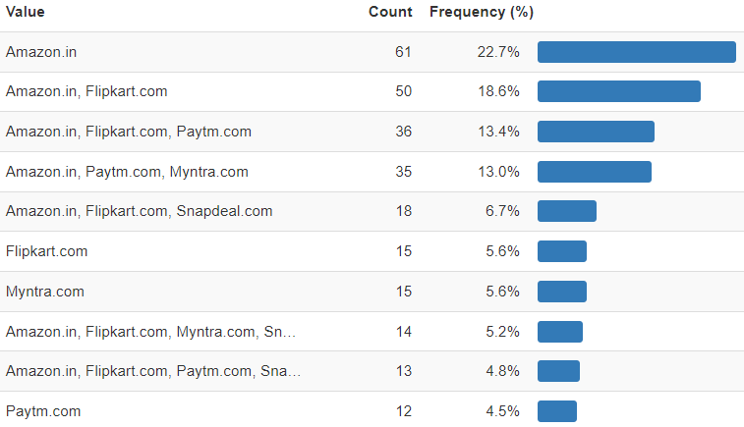
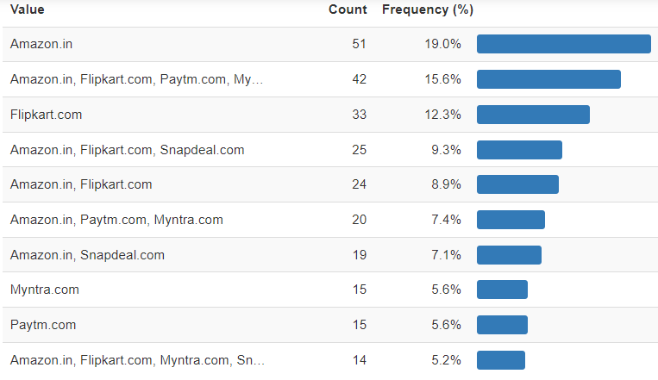
UNIVARIATE ANALYSIS: E-COMMERCE WEBSITE COMPARISON: TRUST FACTOR
33.RELIABILITY OF THE WEBSITE OR APPLICATION
34. SECURITY OF CUSTOMER FINANCIAL OPERATION
OBSERVATION: the votes are quite scattered but most of the rely on amazon among others
OBSERVATION: amazon has secured the data of customers most

Slide 17
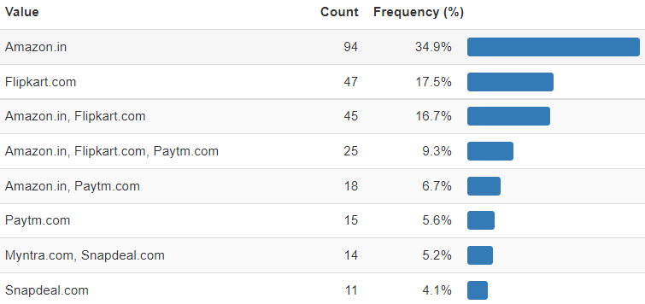
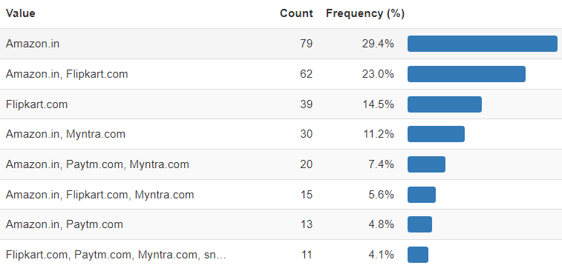
UNIVARIATE ANALYSIS: E-COMMERCE WEBSITE COMPARISON:BRAND LOYALTY
35.WEBSITE IS AS EFFICIENT AS BEFORE
36.WHICH OF THE INDIAN RETAILER WOULD YOU RECOMMEND TO A FRIEND?
OBSERVATION: as per max shoppers amazon is as efficient as before
OBSERVATION: most of the shoppers prefer to recommend amazon

Slide 18
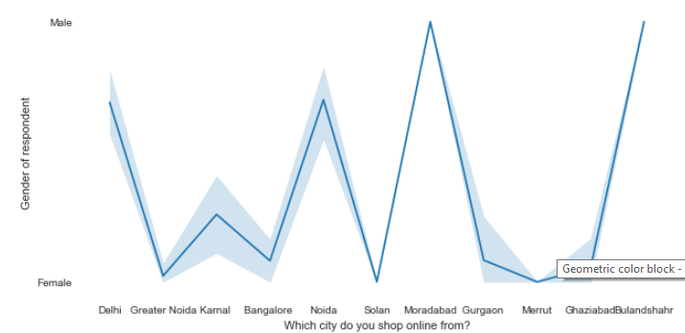
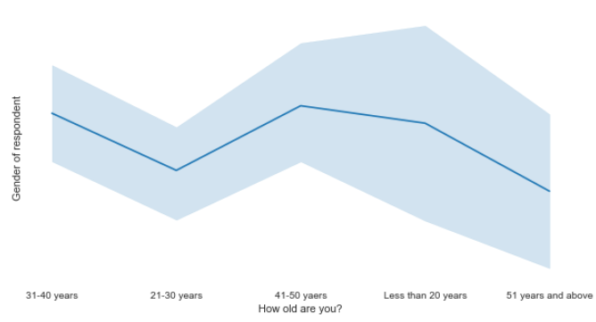
BIVARIATE ANALYSIS
Most of the male shoppers belong to Ghaziabad bulandshahr
Most of the female shoppers belong to solan
Maximum female shoppers are between 21-30 years
Maximum male shoppers are aged 41- 50 years

Slide 19
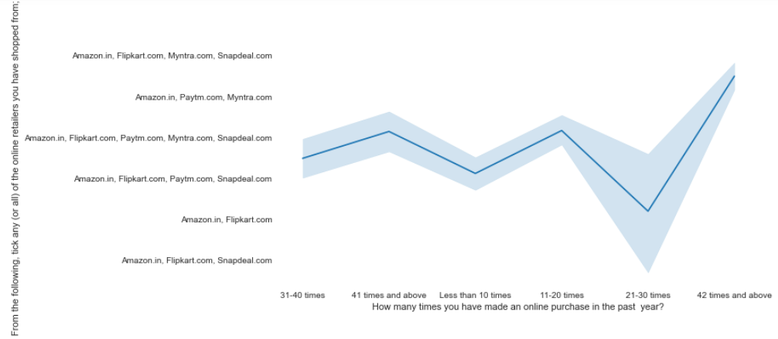
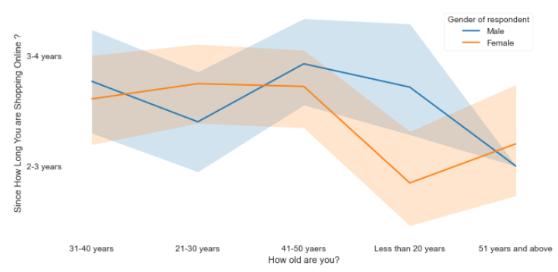
BIVARIATE ANALYSIS
Shoppers who shop 42 times and above in the past year shop max from amazon , flipkart, myntra, snapdeal
All the shoppers shop from amazon
Density of female shoppers is more.
Female shoppers with age 51 and above have started shopping online from last 2-3 years.
Max female shoppers who are less than 20 years have online shopping experience less that 2-3 years

Slide 20
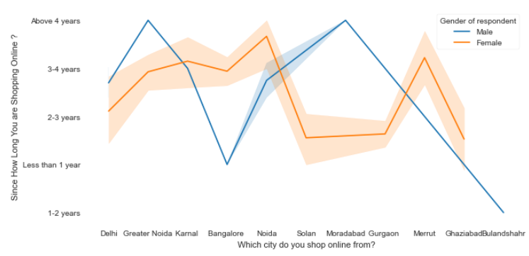
Geographical demography versus choice of website they use
INFERENCES
density of female customers is more than male.
Men living in banglore and ghaziabad shop have shopped online for less than 1 year.
Highest number of men shopping online belong from delhi and noida, while men from moradabad have been shopping online for the longest.
Women from meerut and noida have shopped the longest.

Slide 21
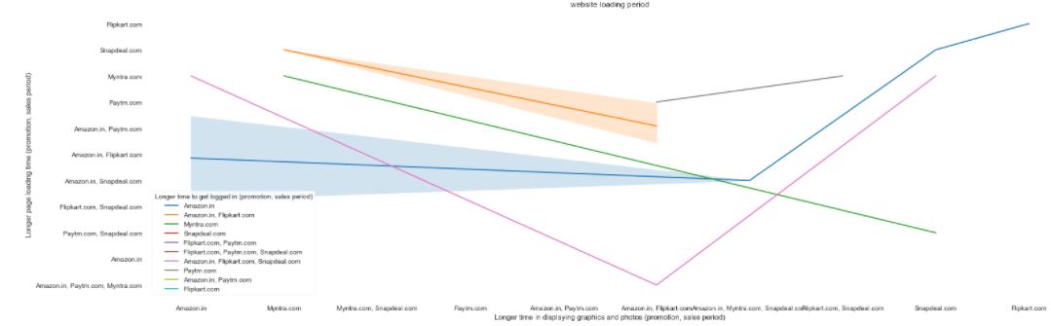
Performance of different websites
Website performance of amazon is the steadiest and is improving
Myntra takes longer duration to load the website and graphics.

Slide 22
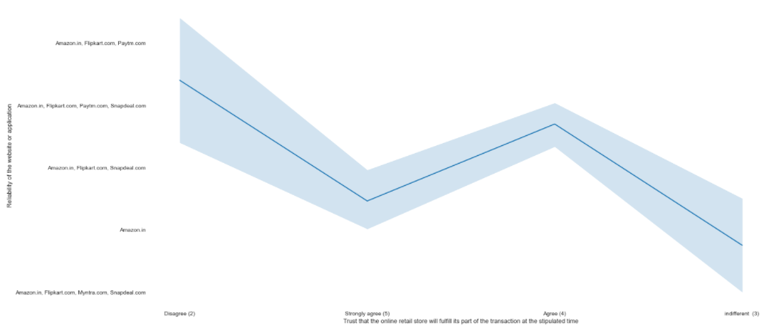
Reliability of websites
Amazon, flipkart and paytm are the most reliable ones
Amzon is least reliable.
Snapdeal is also not reliable

